Slide 1
Lecture 09 – Generative Adversarial Networks
Prof. André Gustavo Hochuli
gustavo.hochuli@pucpr.br
aghochuli@ppgia.pucpr.br
Notes:
Prof. André Hochuli

Slide 2
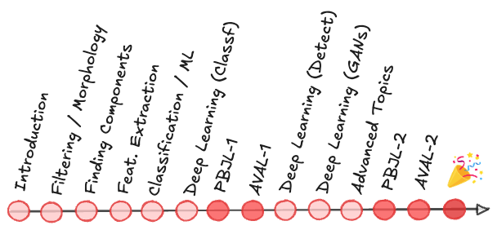
Topics
Review of Lecture 08 – Image Segmentation
Object Detection (Bounding Box Level)
Object Segmentation (Pixel Level)
Generative Adversarial Networks
DCGAN
PIX2PIX
Practice
Computer Vision - Prof. André Hochuli
Lecture 09
Notes:
Prof. André Hochuli

Slide 3
Generative Adversarial Networks (GAN)
Notes:
Prof. André Hochuli

Slide 4
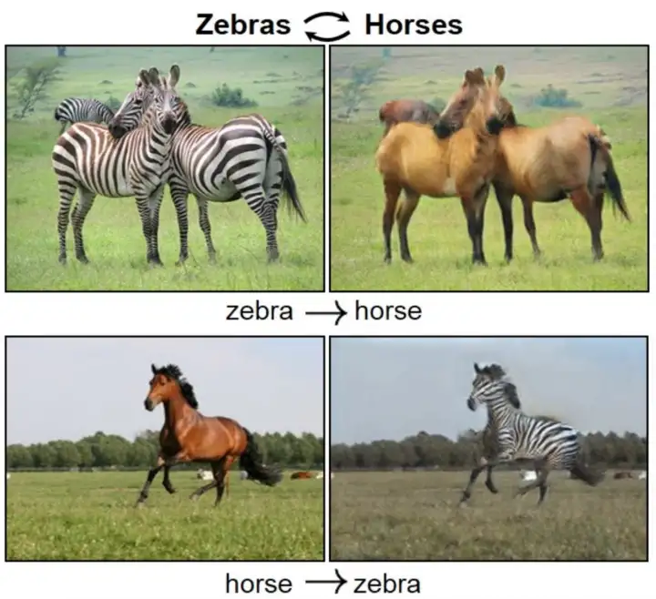
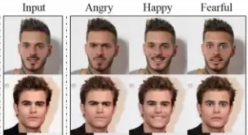
Deep Fakes
Generalization: Synthetic data produced from the learning of real data distribution
Several Applications
Movies (Fake Scenes)
Photo Enhancement (Pose Estimation, Gray2Color, Noise Reduction)
Image Translation
……….
Computer Vision - Prof. André Hochuli
Lecture 09
Notes:
Prof. André Hochuli

Slide 5
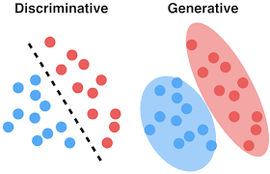
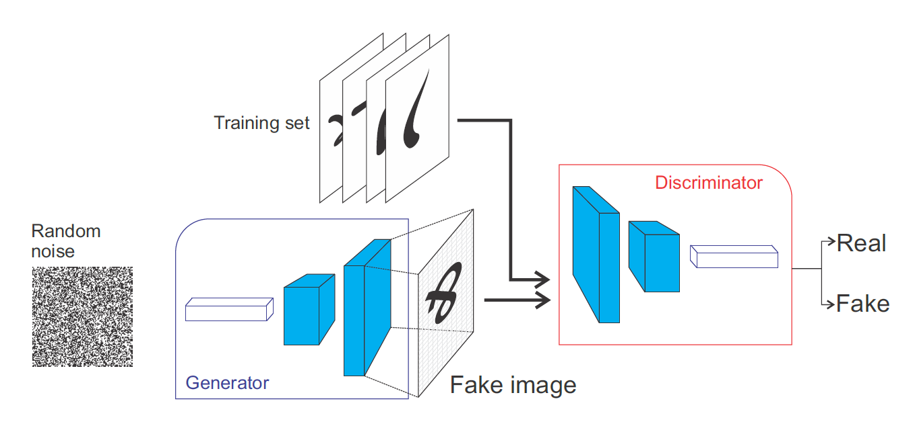
Generative Adversarial Networks (GAN’s)
Generator: Noise → Data
Discriminator: Classification
Computer Vision - Prof. André Hochuli
Lecture 09
Notes:
Prof. André Hochuli

Slide 6
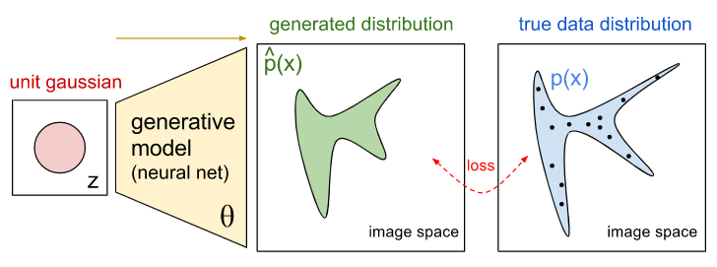
Generative Model
Learns data distribution
Computer Vision - Prof. André Hochuli
Lecture 09
Notes:
Prof. André Hochuli

Slide 7
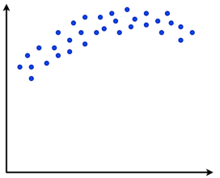
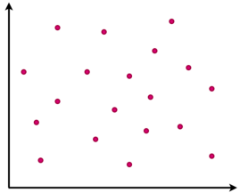
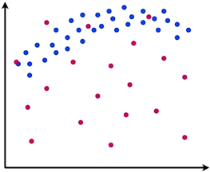
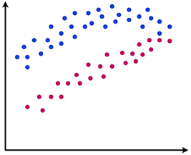
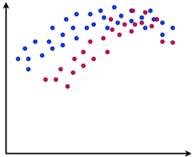
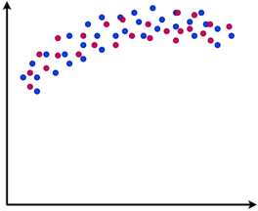
Generative Model
Real
Fake
Training
Computer Vision - Prof. André Hochuli
Lecture 09
Notes:
Prof. André Hochuli

Slide 8
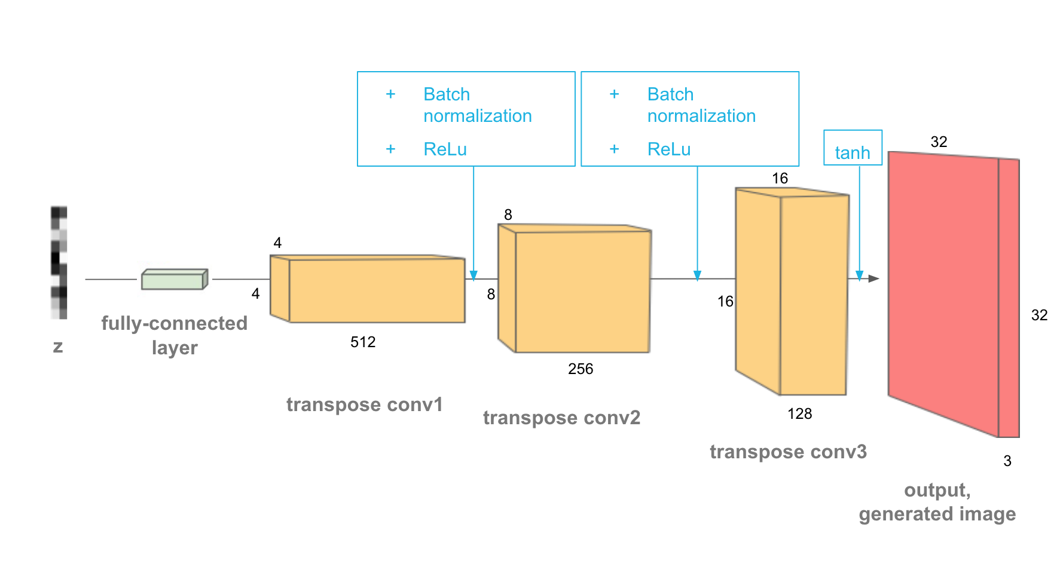
Deep Generative Model
De-Convolutional Layers (upsampling)
Noise to Fake Image
Computer Vision - Prof. André Hochuli
Lecture 09
Notes:
Prof. André Hochuli

Slide 9
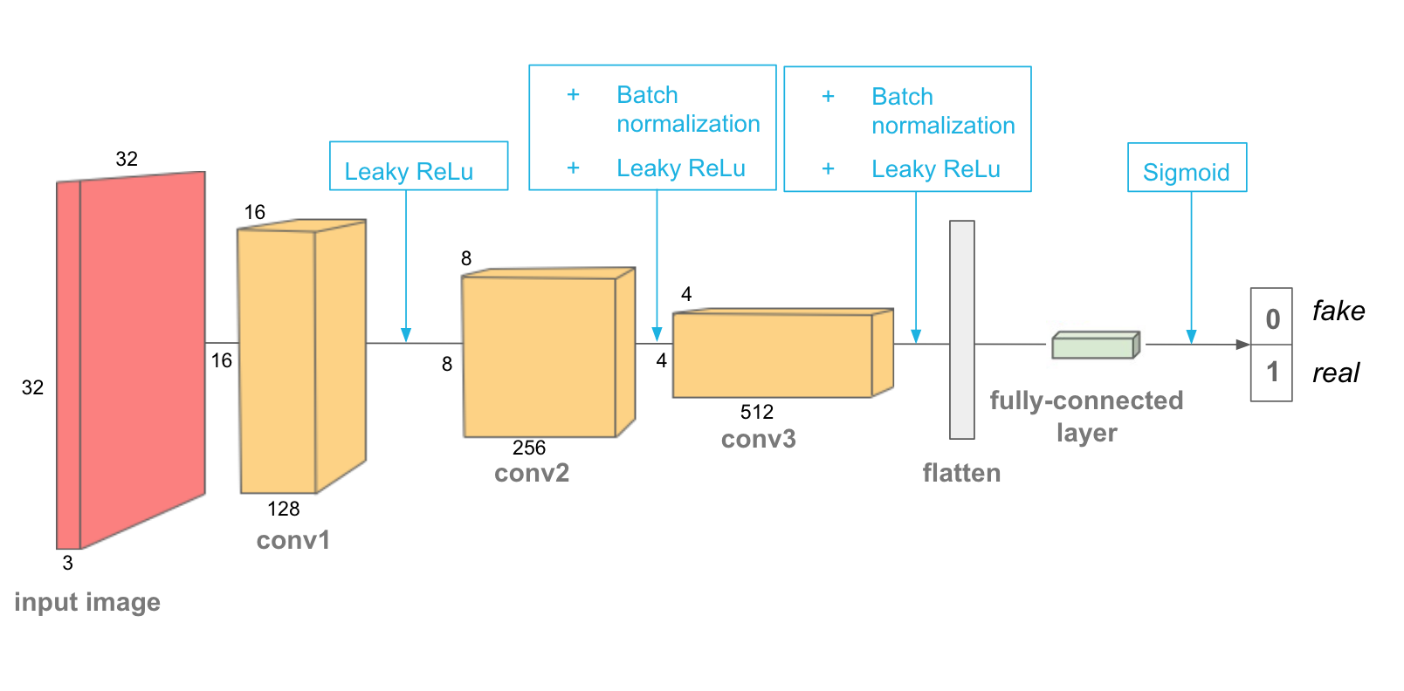
Discriminator Model
Classification: Fake or Real
CNN
Computer Vision - Prof. André Hochuli
Lecture 09
Notes:
Prof. André Hochuli

Slide 10

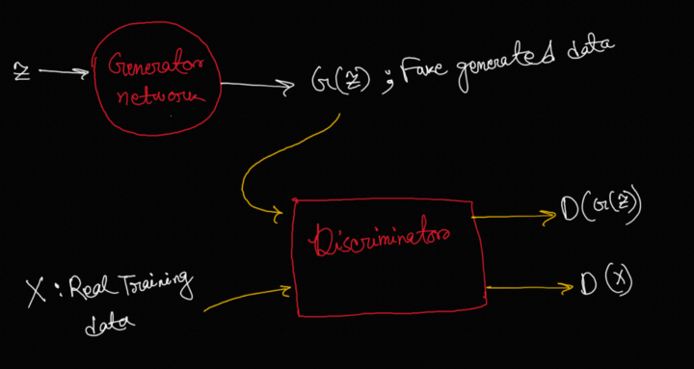
Adversarial Training
Adversarial Loss (Min-Max)
Minimize Generator
Maximize Discriminator
Computer Vision - Prof. André Hochuli
Lecture 09
Notes:
Prof. André Hochuli

Slide 11
Let’s Code
LINK: Lecture_12-DCGAN.ipynb
Computer Vision - Prof. André Hochuli
Lecture 09
Notes:
Prof. André Hochuli

Slide 12
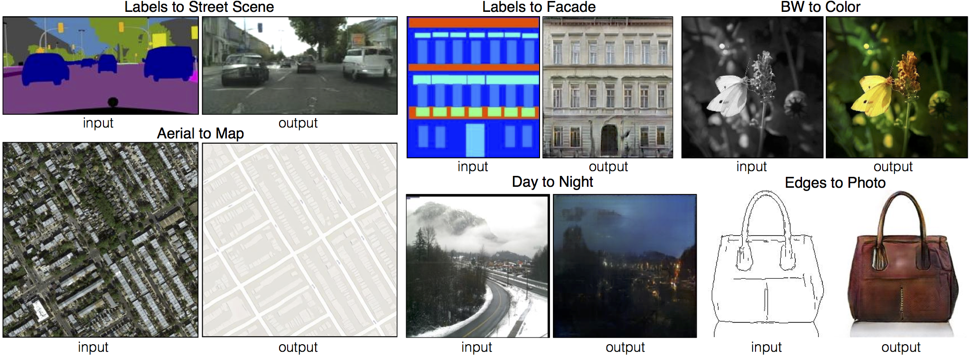
Pix2Pix
Image-Translation
Computer Vision - Prof. André Hochuli
Lecture 09
Notes:
Prof. André Hochuli

Slide 13
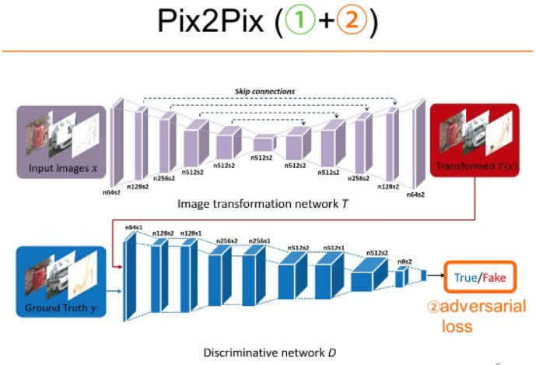
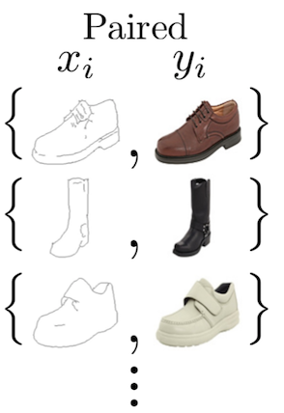
Pix2Pix
Generative Model: Encoder-Decoder Architecture (i.e U-Net)
Paired Annotated Dataset
Computer Vision - Prof. André Hochuli
Lecture 09
Notes:
Prof. André Hochuli

Slide 14
Let’s Code
LINK: Lecture_12-pix2pix.ipynb
Computer Vision - Prof. André Hochuli
Lecture 09
Notes:
Prof. André Hochuli

